Slide 1
Time Series Analysis in Finance
Presented by: Ibtihel Frini
22/05/2026

Slide 2
Bitcoin vs S&P 500: A Volatility Analysis
Analyze return dynamics of Bitcoin and S&P 500
Model returns using ARIMA
Model volatility using GARCH(1,1)
Compare volatility persistence and clustering
Investigate volatility spillovers using VAR and Granger causality
  Research Question:
  Do Bitcoin and the S&P 500 exhibit similar return dynamics and volatility patterns?
Notes:
Today I will present my analysis comparing Bitcoin and the S&P 500, focusing on their return dynamics and volatility behavior.
The goal of this study is to understand whether these two markets behave similarly from a time series perspective.
Specifically, I want to answer whether Bitcoin and the S&P 500 exhibit similar return patterns and volatility structures, and whether standard models like ARIMA and GARCH can capture these characteristics.

Slide 3
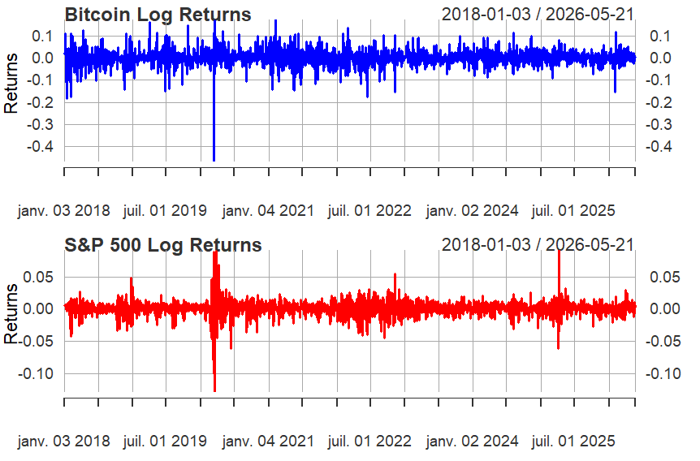
Data & Methodology
Data:
  Bitcoin (BTC-USD)
  S&P 500 (^GSPC)
  Daily data (2018–2025)
Methodology:
  Log returns transformation
  Alignment of common trading dates
  ADF test (stationarity)
  ACF/PACF analysis
  ARIMA → return dynamics
  GARCH(1,1) → conditional volatility
  VAR + Granger causality → volatility spillovers
Notes:
For this analysis, I used daily data for Bitcoin and the S&P 500 from 2018 to 2025, obtained from Yahoo Finance.
I transformed the data into log returns, which is standard in financial time series analysis, since returns are more stable than prices.
Because Bitcoin trades every day while the S&P 500 only trades on market days, the return series were aligned using common trading dates before estimation.
Then, I first tested for stationarity using the Augmented Dickey-Fuller test.
To model the return dynamics, I used ARIMA models, which capture any linear relationships in the data.
After that, I applied GARCH models to capture time-varying volatility, since financial data typically shows volatility clustering.

Slide 4
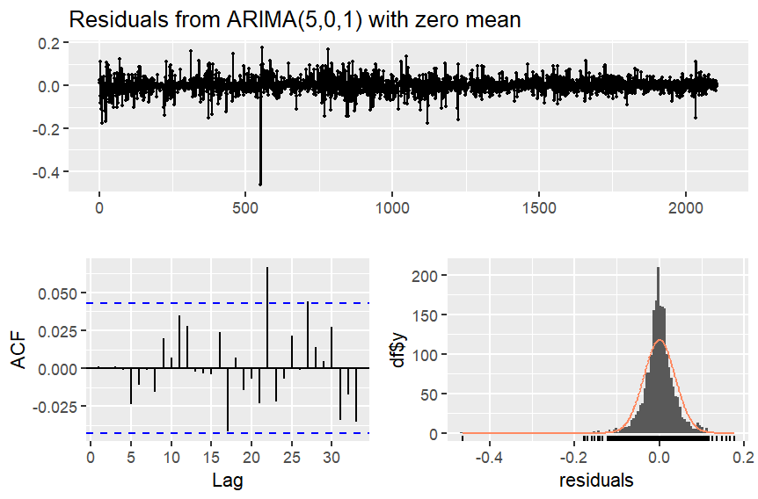
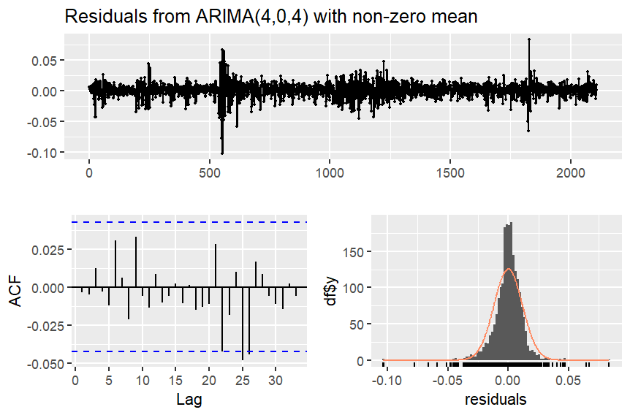
Return Dynamics
Weak autocorrelation in both series
Bitcoin: ARIMA(5,0,1)
S&P 500: ARIMA(4,0,4)
Residuals show no residual
autocorrelation (Ljung-Box p > 0.05)
Conclusion:
  Returns exhibit limited linear predictability
Notes:
The ARIMA results show that both Bitcoin and the S&P 500 have very weak autocorrelation in their returns.
For Bitcoin, the selected model was ARIMA(5,0,1), and for the S&P 500, ARIMA(4,0,4).
However, even with these models, the predictive power is very limited.
Residual diagnostics confirm that there is no remaining autocorrelation, which means the models are correctly specified.
Overall, this suggests that returns exhibit limited linear predictability, which is consistent with financial market efficiency.

Slide 5
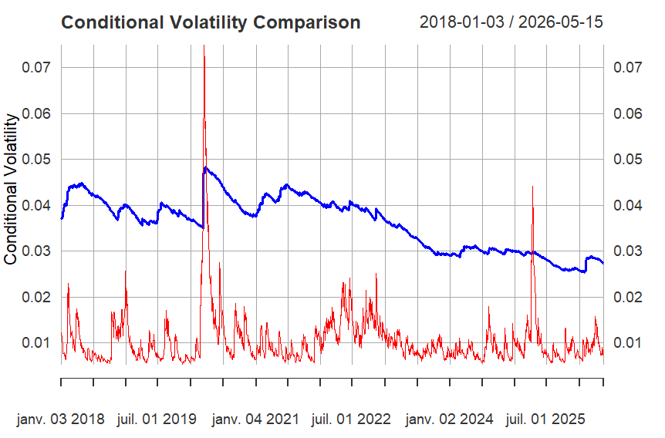
GARCH Results
Strong volatility clustering observed
High volatility persistence:
  Bitcoin: α + β ≈ 0.999
  S&P 500: α + β ≈ 0.962
Key Insight:
  Bitcoin → higher volatility
  S&P 500 → volatility is lower but
  exhibits temporary spikes during
  market stress
  Volatility spillovers detected between
  both markets
Granger Causality:
Significant bidirectional volatility influence (p < 0.01)
Notes:
When we move to volatility, we observe much stronger patterns in both markets.
Both series exhibit volatility clustering, meaning that periods of high volatility tend to persist over time.
Using GARCH(1,1), I find that volatility persistence is very high in both assets.
For Bitcoin, the persistence parameter is approximately 0.999, while for the S&P 500 it is around 0.962.
This means that volatility shocks decay slowly, especially in Bitcoin.
However, there are important differences between the two markets.
Bitcoin maintains a much higher and more persistent level of volatility, reflecting its speculative nature.
The S&P 500 is more stable overall, although it still experiences temporary spikes during periods of market stress due to global events.
To further analyze the relationship between both markets, I applied a VAR-based Granger causality test on the volatility series.
The results show statistically significant bidirectional causality, meaning that volatility in one market helps predict volatility in the other.
Overall, the findings suggest significant cross-market volatility spillovers between cryptocurrency markets and traditional financial markets.

Slide 6
Conclusion
Both return series are stationary
Returns exhibit weak linear predictability
Strong volatility clustering observed
Bitcoin shows persistently higher volatility
Significant volatility spillovers detected
ARIMA and GARCH effectively model financial time series behavior
ARIMA and GARCH effectively capture financial time series behavior.
Notes:
In conclusion, both Bitcoin and the S&P 500 show similar statistical properties in terms of stationarity and weak return predictability.
However, both exhibit strong volatility clustering, which is well captured by GARCH models.
Bitcoin is clearly more volatile and shows stronger persistence, while the S&P 500 is relatively more stable.
Finally, the presence of overlapping volatility spikes suggests some degree of interconnected behavior between the two markets.
Overall, this analysis shows that ARIMA and GARCH models are effective tools for understanding financial time series.
Limitations & Future Research
Univariate GARCH may not fully capture multivariate dependence
Future research could apply multivariate volatility models (e.g., DCC-GARCH)

